Slide 1
Introduction to Python Programming
Dr. C S Prasanth
Assistant Professor
PG Department of Physics
N S S College Pandalam
21JUN19

Slide 2
Syllabus

Slide 3
What is Python?
Python is a high-level programming language
Open source and community driven
“Batteries Included”
a standard distribution includes many modules
Dynamic typed
Source can be compiled or run just-in-time

Slide 4
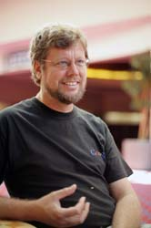
python Timeline/History
Python was conceived in the late 1980s.
Guido van Rossum, Benevolent Dictator For Life
Rossum is Dutch, born in Netherlands, Christmas break bored, big fan of Monty python’s Flying Circus
In 1991 python 0.9.0 was published and reached the masses through alt.sources
In January of 1994 python 1.0 was released
Functional programming tools like lambda, map, filter, and reduce
comp.lang.python formed, greatly increasing python’s userbase

Slide 5
python Timeline/History
In 1995, python 1.2 was released.
By version 1.4 python had several new features
Keyword arguments (similar to those of common lisp)
Built-in support for complex numbers
Basic form of data-hiding through name mangling (easily bypassed however)
Computer Programming for Everybody (CP4E) initiative
Make programming accessible to more people, with basic “literacy” similar to those required for English and math skills for some jobs.
Project was funded by DARPA
CP4E was inactive as of 2007, not so much a concern to get employees programming “literate”

Slide 6
python Timeline/History
In 2000, Python 2.0 was released.
Introduced list comprehensions similar to Haskells
Introduced garbage collection
In 2001, Python 2.2 was released.
Included unification of types and classes into one hierarchy, making pythons object model purely Object-oriented
Generators were added(function-like iterator behavior)

Slide 7
Python Interfaces
IDLE – a cross-platform Python development environment
PythonWin – a Windows only interface to Python
Python Shell – running 'python' from the Command Line opens this interactive shell

Slide 8
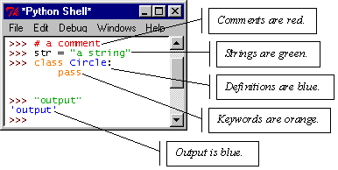
IDLE – Development Environment
IDLE helps you program in Python by:
color-coding your program code
debugging
auto-indent
interactive shell

Slide 9
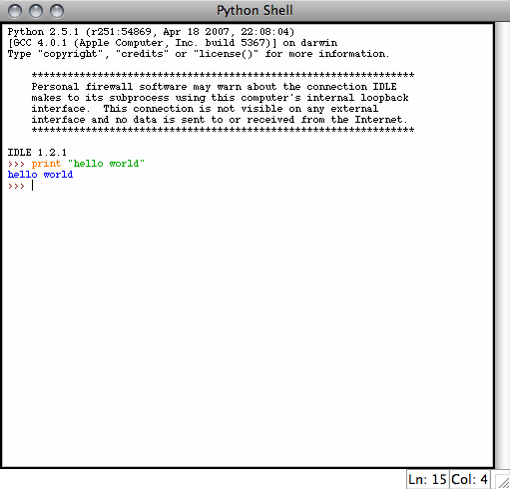
Example Python
Hello World
print “hello world”
Prints hello world to standard out
Open IDLE and try it out yourself
Follow along using IDLE

Slide 10
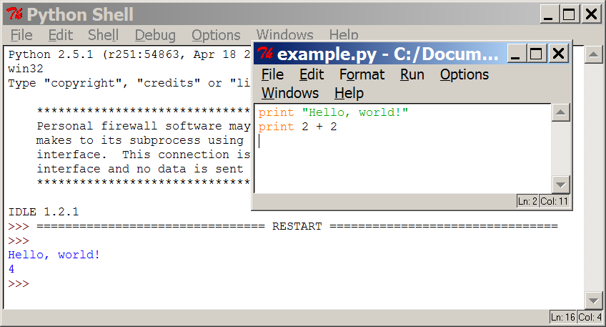
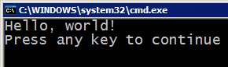
Programming basics
code or source code: The sequence of instructions in a program.
syntax: The set of legal structures and commands that can be used in a particular programming language.
output: The messages printed to the user by a program.
console: The text box onto which output is printed.
Some source code editors pop up the console as an external window, and others contain their own console window.

Slide 11
Compiling and interpreting
Many languages require you to compile (translate) your program into a form that the machine understands.
Python is instead directly interpreted into machine instructions.
compile
execute
source code
Hello.java
byte code
Hello.class
output
interpret
source code
Hello.py
output

Slide 12
Real numbers
Python can also manipulate real numbers.
Examples: 6.022 -15.9997 42.0 2.143e17
The operators + - * / % ** ( ) all work for real numbers.
The / produces an exact answer: 15.0 / 2.0 is 7.5
The same rules of precedence also apply to real numbers: Evaluate ( ) before * / % before + -
When integers and reals are mixed, the result is a real number.
Example: 1 / 2.0 is 0.5
The conversion occurs on a per-operator basis.
7 / 3 * 1.2 + 3 / 2
2 * 1.2 + 3 / 2
2.4 + 3 / 2
2.4 + 1
3.4

Slide 13
Math commands
Python has useful commands for performing calculations.
To use many of these commands, you must write the following at the top of your Python program:
from math import *
Command name | Description
abs(value) | absolute value
ceil(value) | rounds up
cos(value) | cosine, in radians
floor(value) | rounds down
log(value) | logarithm, base e
log10(value) | logarithm, base 10
max(value1, value2) | larger of two values
min(value1, value2) | smaller of two values
round(value) | nearest whole number
sin(value) | sine, in radians
sqrt(value) | square root
Constant | Description
e | 2.7182818...
pi | 3.1415926...

Slide 14
Variables
variable: A named piece of memory that can store a value.
Usage:
Compute an expression's result,
store that result into a variable,
and use that variable later in the program.
assignment statement: Stores a value into a variable.
Syntax:
name = value
A variable that has been given a value can be used in expressions.

Slide 15
print
print : Produces text output on the console.
Syntax:
print "Message"
print Expression
Prints the given text message or expression value on the console, and moves the cursor down to the next line.
print Item1, Item2, ..., ItemN
Prints several messages and/or expressions on the same line.
Examples:
print "Hello, world!"
age = 45
print "You have", 65 - age, "years until retirement"
Output:
Hello, world!
You have 20 years until retirement

Slide 16
More than just printing
Python is an object oriented language
Practically everything can be treated as an object
“hello world” is a string
Strings, as objects, have methods that return the result of a function on the string

Slide 17
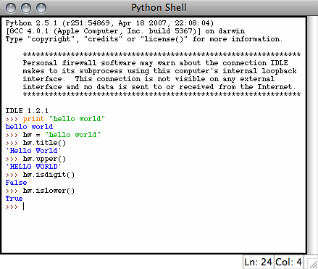
String Methods
Assign a string to a variable
In this case “hw”
hw.title()
hw.upper()
hw.isdigit()
hw.islower()

Slide 18
String Methods
The string held in your variable remains the same
The method returns an altered string
Changing the variable requires reassignment
hw = hw.upper()
hw now equals “HELLO WORLD”

Slide 19
input
input : Reads a number from user input.
You can assign (store) the result of input into a variable.
Example:
age = input("How old are you? ")
print "Your age is", age
print "You have", 65 - age, "years until retirement"
Output:
How old are you? 53
Your age is 53
You have 12 years until retirement

Slide 20
Other Python Objects
Lists (mutable sets of strings)
var = [] # create list
var = [‘one’, 2, ‘three’, ‘banana’]
Tuples (immutable sets)
var = (‘one’, 2, ‘three’, ‘banana’)
Dictionaries (associative arrays or ‘hashes’)
var = {} # create dictionary
var = {‘lat’: 40.20547, ‘lon’: -74.76322}
var[‘lat’] = 40.2054
Each has its own set of methods

Slide 21
Tuples
A tuple is a sequence of immutable Python objects., means you cannot update or change the values of tuple elements
Tuples are sequences, just like lists.
The differences between tuples and lists are, the tuples cannot be changed unlike lists and tuples use parentheses, whereas lists use square brackets.
Like string indices, tuple indices start at 0

Slide 22
Accessing Values in Tuples
To access values in tuple, use the square brackets for slicing along with the index or indices to obtain value available at that index. For example −
#!/usr/bin/python
tup1 = ('physics', 'chemistry', 1997, 2000);
tup2 = (1, 2, 3, 4, 5, 6, 7 );
print "tup1[0]: ", tup1[0];
print "tup2[1:5]: ", tup2[1:5];

Slide 23
Basic Tuples Operations
Tuples respond to the + and * operators much like strings; they mean concatenation and repetition here too, except that the result is a new tuple, not a string.

Slide 24
Indentation and Blocks
Python uses whitespace and indents to denote blocks of code
Lines of code that begin a block end in a colon:
Lines within the code block are indented at the same level
To end a code block, remove the indentation
You'll want blocks of code that run only when certain conditions are met

Slide 25
Repetition (loops) and Selection (if/else)

Slide 26
Conditional Branching
if and else
if variable == condition: #do something based on v == c
else:
#do something based on v != c
elif allows for additional branching
if condition:
elif another condition:
…
else: #none of the above

Slide 27
The for loop
for loop: Repeats a set of statements over a group of values.
Syntax:
for variableName in groupOfValues:
statements
We indent the statements to be repeated with tabs or spaces.
variableName gives a name to each value, so you can refer to it in the statements.
groupOfValues can be a range of integers, specified with the range function.
Example:
for x in range(1, 6):
print x, "squared is", x * x
Output:
1 squared is 1
2 squared is 4
3 squared is 9
4 squared is 16
5 squared is 25

Slide 28
range
The range function specifies a range of integers:
range(start, stop) - the integers between start (inclusive)
and stop (exclusive)
It can also accept a third value specifying the change between values.
range(start, stop, step) - the integers between start (inclusive)
and stop (exclusive) by step
Example:
for x in range(5, 0, -1):
print x
Output:
5
4
3
2
1

Slide 29
Cumulative loops
Some loops incrementally compute a value that is initialized outside the loop. This is sometimes called a cumulative sum.
sum = 0
for i in range(1, 11):
sum = sum + (i * i)
print "sum of first 10 squares is", sum
Output:
sum of first 10 squares is 385

Slide 30
Looping with For
For allows you to loop over a block of code a set number of times
For is great for manipulating lists:
a = ['cat', 'window', 'defenestrate'] for x in a: print x, len(x)
Results:
cat 3
window 6
defenestrate 12

Slide 31
Looping with For
We could use a for loop to perform geoprocessing tasks on each layer in a list
We could get a list of features in a feature class and loop over each, checking attributes
Anything in a sequence or list can be used in a For loop
Just be sure not to modify the list while looping

Slide 32
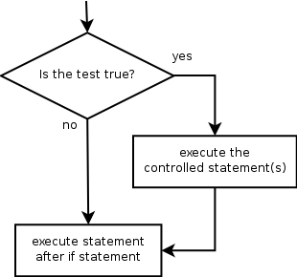
if
if statement: Executes a group of statements only if a certain condition is true. Otherwise, the statements are skipped.
Syntax:
if condition:
statements
Example:
gpa = 3.4
if gpa > 2.0:
print "Your application is accepted."

Slide 33
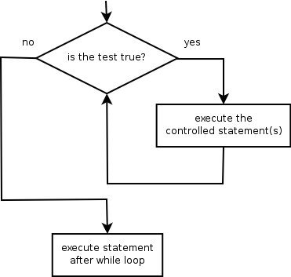
while
while loop: Executes a group of statements as long as a condition is True.
good for indefinite loops (repeat an unknown number of times)
Syntax:
while condition:
statements
Example:
number = 1
while number < 200:
print number,
number = number * 2
Output:
1 2 4 8 16 32 64 128

Slide 34
Logic
Many logical expressions use relational operators:
Logical expressions can be combined with logical operators:
Operator | Meaning | Example | Result
== | equals | 1 + 1 == 2 | True
!= | does not equal | 3.2 != 2.5 | True
< | less than | 10 < 5 | False
> | greater than | 10 > 5 | True
<= | less than or equal to | 126 <= 100 | False
>= | greater than or equal to | 5.0 >= 5.0 | True
Operator | Example | Result
and | 9 != 6 and 2 < 3 | True
or | 2 == 3 or -1 < 5 | True
not | not 7 > 0 | False

Slide 35
Text and File Processing

Slide 36
Modules
Modules are additional pieces of code that further extend Python’s functionality
A module typically has a specific function
additional math functions, databases, network…
Python comes with many useful modules
arcgisscripting is the module we will use to load ArcGIS toolbox functions into Python

Slide 37
Modules
Modules are accessed using import
import sys, os # imports two modules
Modules can have subsets of functions
os.path is a subset within os
Modules are then addressed by modulename.function()
sys.argv # list of arguments
filename = os.path.splitext("points.txt")
filename[1] # equals ".txt"

Slide 38
Files
Files are manipulated by creating a file object
f = open("points.txt", "r")
The file object then has new methods
print f.readline() # prints line from file
Files can be accessed to read or write
f = open("output.txt", "w")
f.write("Important Output!")
Files are iterable objects, like lists

Slide 39
Strings
string: A sequence of text characters in a program.
Strings start and end with quotation mark " or apostrophe ' characters.
Examples: "hello" "This is a string" "This, too, is a string. It can be very long!"
A string may not span across multiple lines or contain a " character. "This is not a legal String."
"This is not a "legal" String either."
A string can represent characters by preceding them with a backslash.
\t tab character
\n new line character
\" quotation mark character
\\ backslash character
Example: "Hello\tthere\nHow are you?"

Slide 40
Indexes
Characters in a string are numbered with indexes starting at 0:
Example:
name = "P. Diddy"
Accessing an individual character of a string:
variableName [ index ]
Example:
print name, "starts with", name[0]
Output:
P. Diddy starts with P
index | 0 | 1 | 2 | 3 | 4 | 5 | 6 | 7
character | P | . |  | D | i | d | d | y

Slide 41
String properties
len(string) - number of characters in a string
(including spaces)
str.lower(string) - lowercase version of a string
str.upper(string) - uppercase version of a string

Slide 42
File processing
Many programs handle data, which often comes from files.
Reading the entire contents of a file:
variableName = open("filename").read()
Example:
file_text = open("bankaccount.txt").read()

